Slide 1
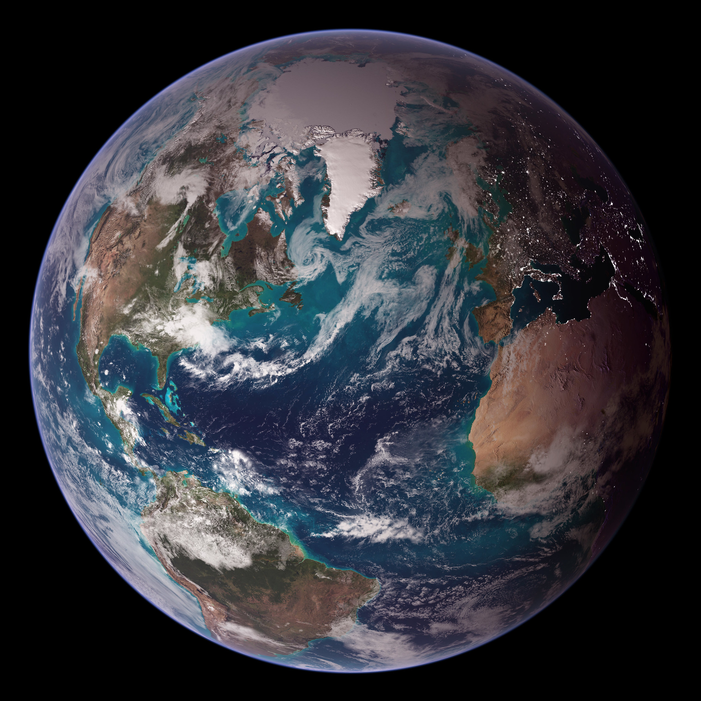

TerraMind: Large-Scale Generative Multimodality for Earth Observation
IGARSS’25 – Tutorial
Bianca Zadrozny
Credit: NASA/Goddard Space Flight Center
Notes:
Image source: https://www.flickr.com/photos/gsfc/4426654941 Attribution (CC BY 2.0)
NASA Blue Marble 2007 West
RELEASE DATE: OCTOBER 9, 2007
Credit: NASA/Goddard Space Flight Center/Reto Stöckli

Slide 2
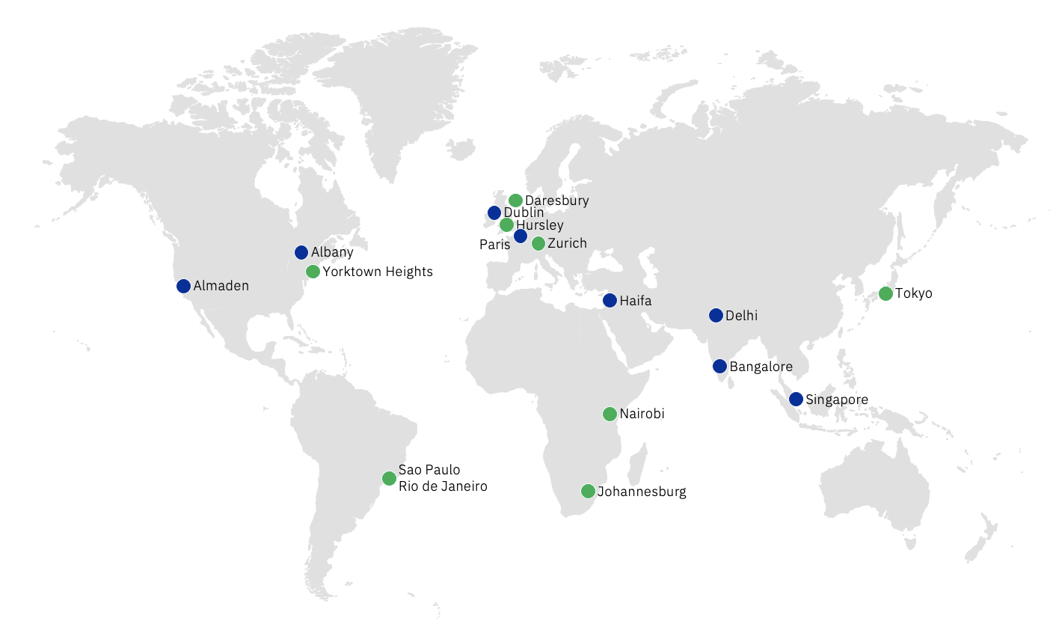
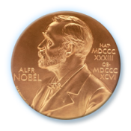



IBM Research
3000
Researchers
78
Years
6 Nobel Laureates
10 Medals of Technology
5 National Medals of Science
6 Turing Awards
Climate and Sustainability Research

Slide 3
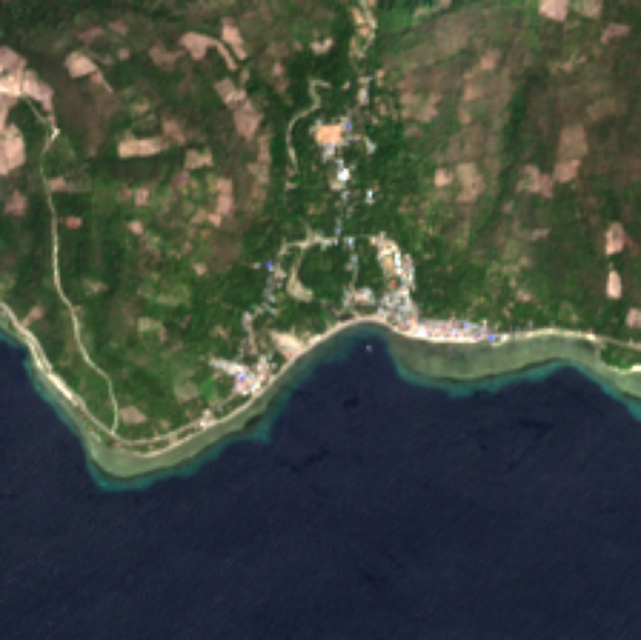
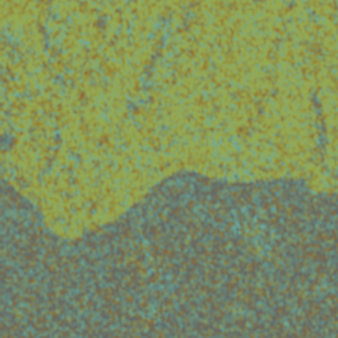
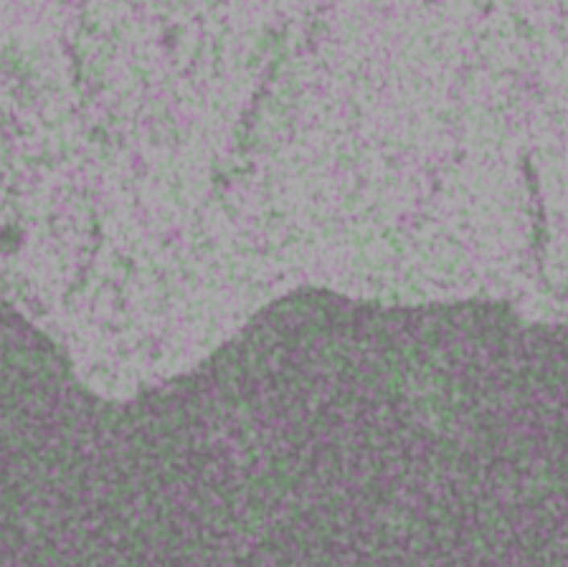
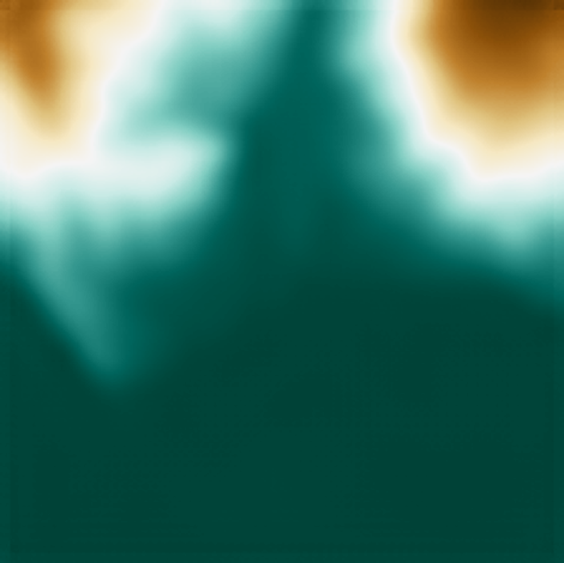
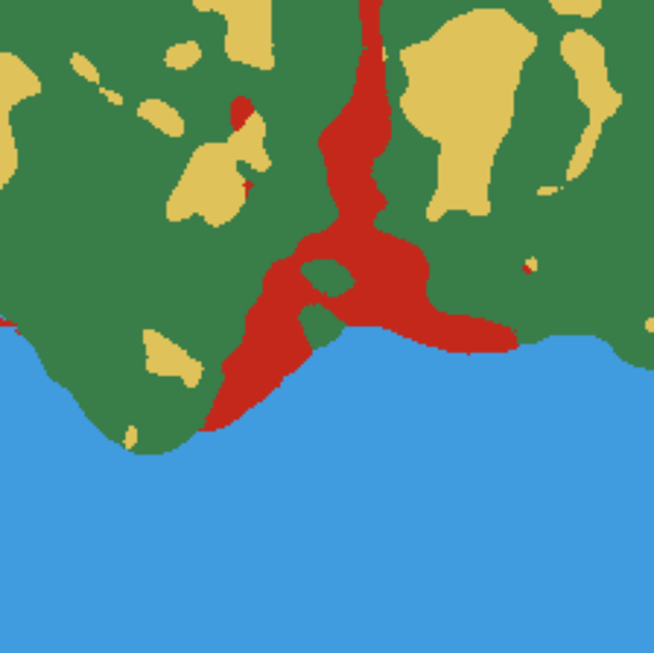
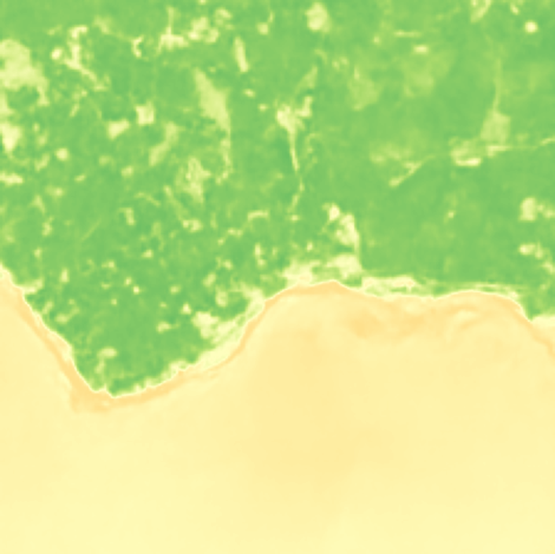

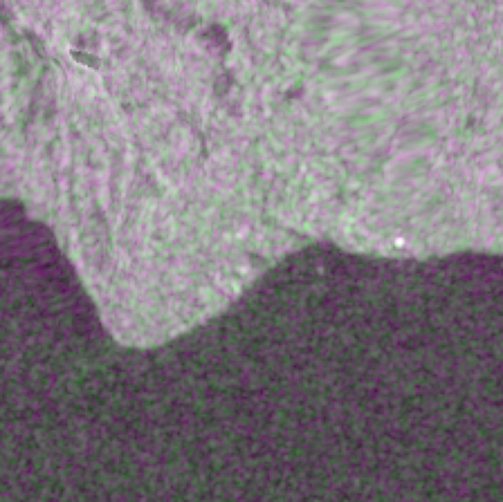
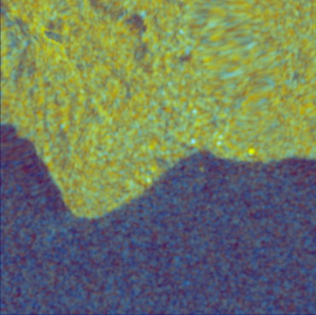
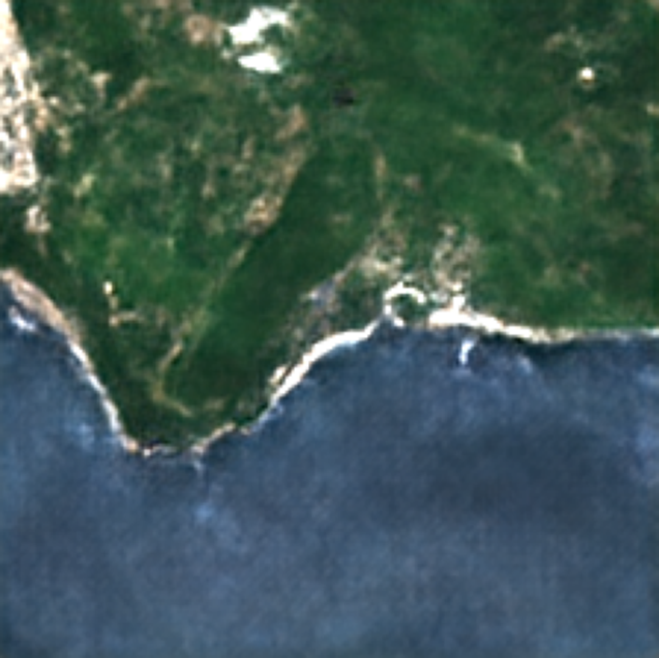
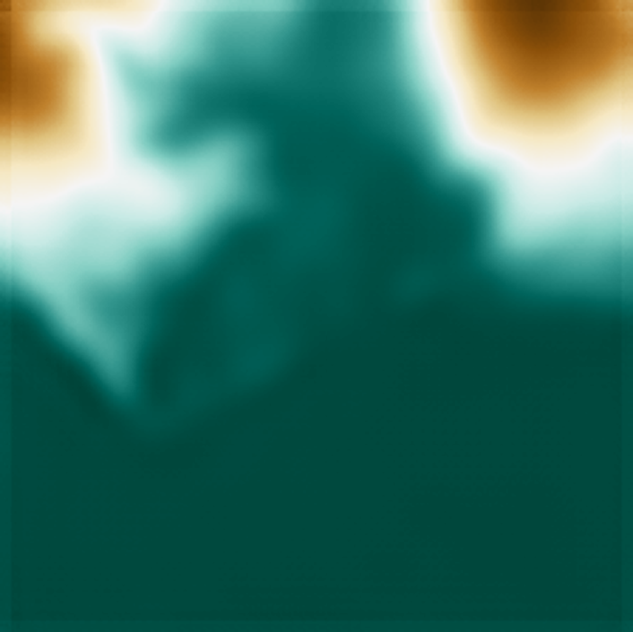
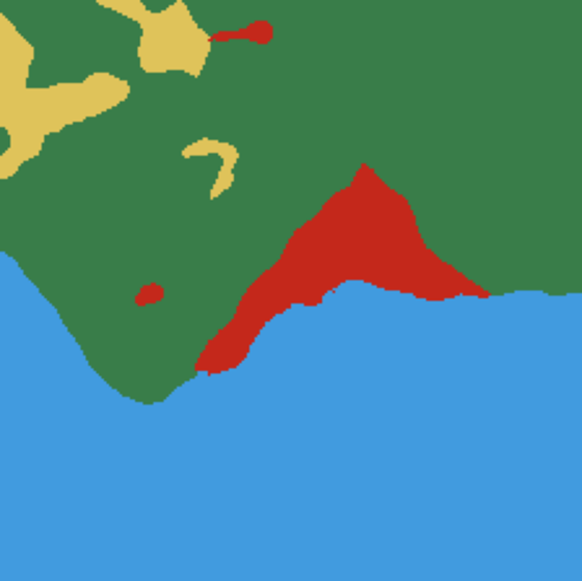
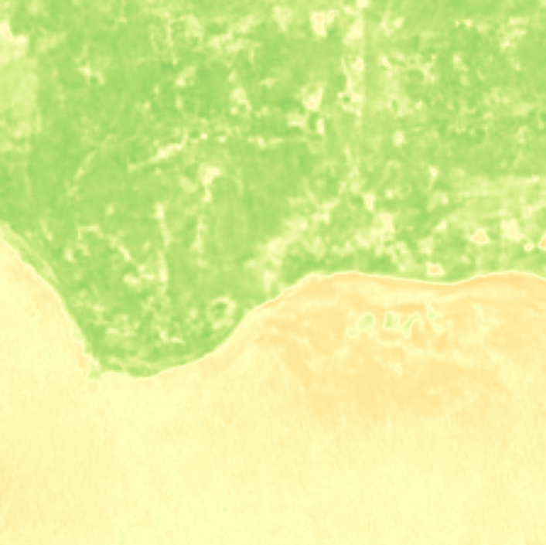
TerraMind – our first foundation model with cross-modal understanding
Raw Input
Sentinel-2 L2A
Sentinel-1 RTC
DEM
LULC
NDVI
Generation
Generation

Slide 4
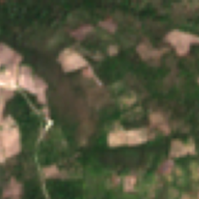
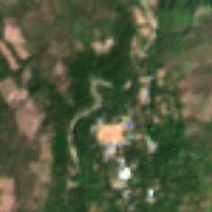
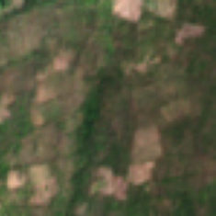
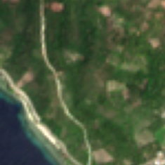
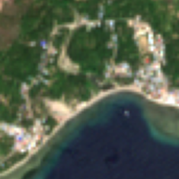

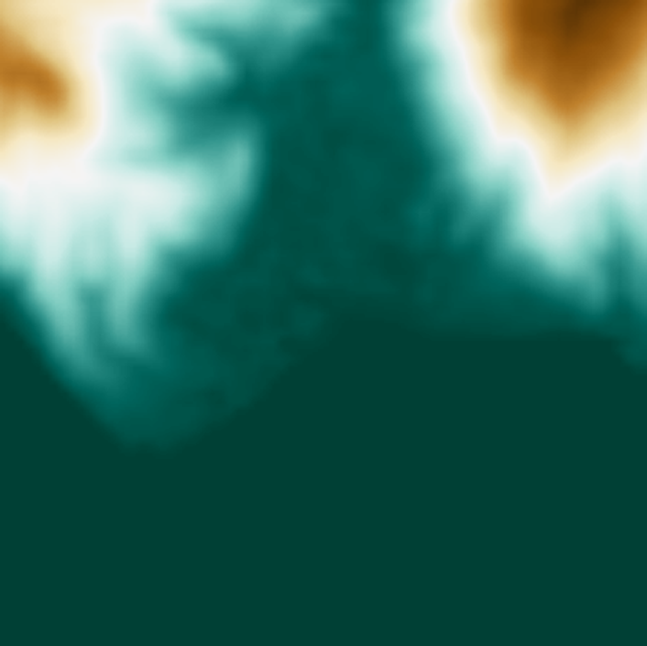
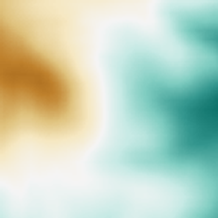






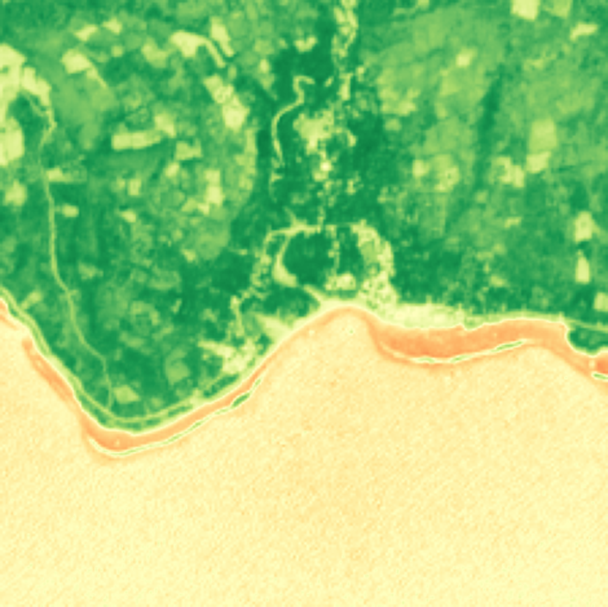
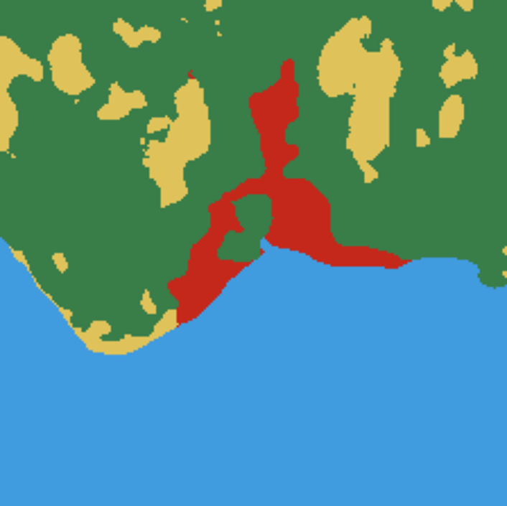
TerraMind
Modalities
Modality-wise Tokenization
Correlation Learning
Sentinel-2 L2A
Sentinel-2 L1C
Sentinel-2 RGB
Pixel-level input
Sampled target tokens
…
S-2 L2A
…
S-2 L1C
Patch Embed.
TerraMind is our first any-to-any generative, large-scale multimodal FM for EO and is pre-trained on 500 billion tokens using diverse geospatial data.
Sentinel-1 GRD
Sentinel-1 RTC
…
S-2 RGB
Cross Entropy Loss
…
S-1 GRD
…
S-1 RTC
TerraMind Decoder
Digital Elevation Model (DEM)
…
DEM
Token-level input
Vegetation index (NDVI)
…
S-2 L2A
Image Token-ization
…
S-1 GRD
…
S-1 RTC
Mask tokens
Land-use/ land-cover maps (LULC)
…
DEM
…
NDVI
…
LULC
TerraMind Encoder
Image caption
A satellite image of a coastline with …
Text Token-ization
Sequence input
…
Caption
Coordinates at 0.25 x 0.25 deg
0°50′N 122°75′E
Coords
Sampled input tokens
Jakubik, J., Yang, F., Blumenstiel, B., Scheurer, E., Sedona, R., Maurogiovanni, S., ... & Longépé, N. (2025). TerraMind: Large-Scale Generative Multimodality for Earth Observation. arXiv preprint arXiv:2504.11171.

Slide 5
The training data – 9M spatio-temporal locations with multiple modalities from TerraMesh dataset
Blumenstiel, B., Fraccaro, P., Marsocci, V., Jakubik, J., Maurogiovanni, S., Czerkawski, M., ... & Longépé, N. (2025). TerraMesh: A Planetary Mosaic of Multimodal Earth Observation Data. arXiv preprint arXiv:2504.11172.

Slide 6
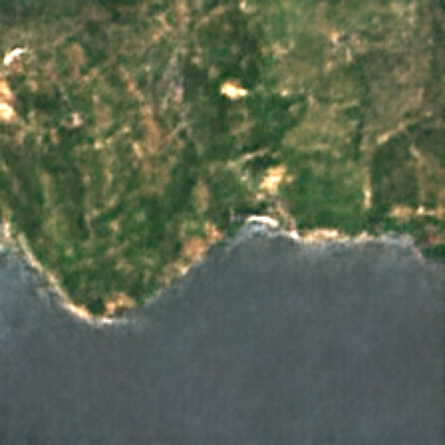

Tokens are good pre-training targets
TerraMind uses
Vector-quantized Variational Auto-Encoders (VQ-VAE)
with diffusion steps
for tokenization.
The tokenizer of each modality is trained separate and uses Finite State Quantization (FSQ) with a codebook size of 15,360 tokens.
Raw Input
Finite State Quantization¹ (FSQ)
Reconstruction
ViT-B
Encoder
Diffusion
Decoder
…
…
Codebook
1 Mentzer, F., Minnen, D., Agustsson, E., & Tschannen, M. (2023). Finite scalar quantization: Vq-vae made simple. arXiv preprint arXiv:2309.15505.

Slide 7
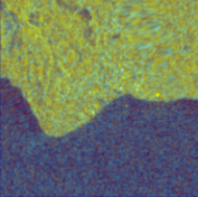
Fusing the modalities with correlation learning
Sampled target tokens
Inputs
Latent representation
Cross entropy loss
TerraMind Encoder
TerraMind Decoder
0°50′N 122°75′E
0°50′N 122°75′E
Sampled input tokens
Mask tokens
Mizrahi, D., Bachmann, R., Kar, O., Yeo, T., Gao, M., Dehghan, A., & Zamir, A. (2023). 4m: Massively multimodal masked modeling. Advances in Neural Information Processing Systems.

Slide 8
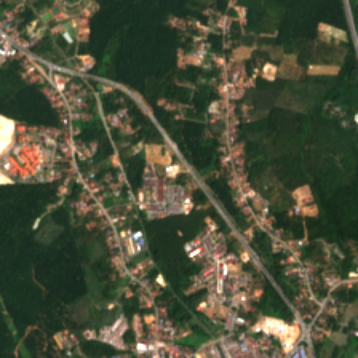
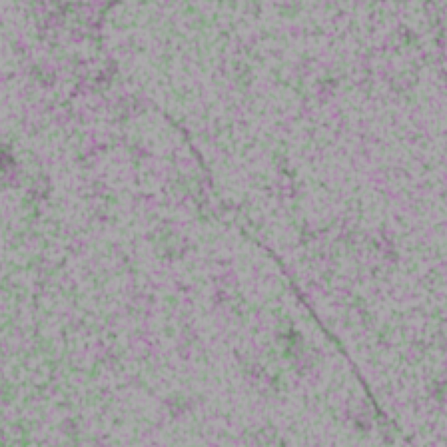
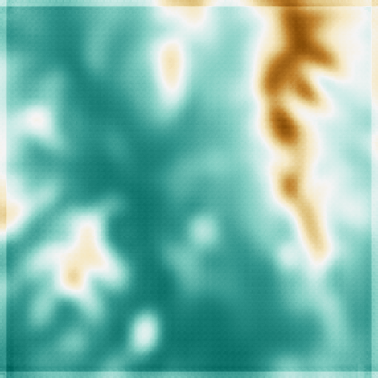

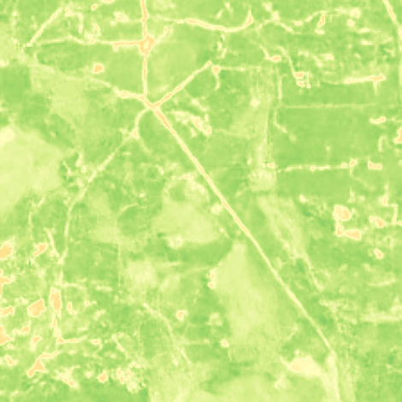
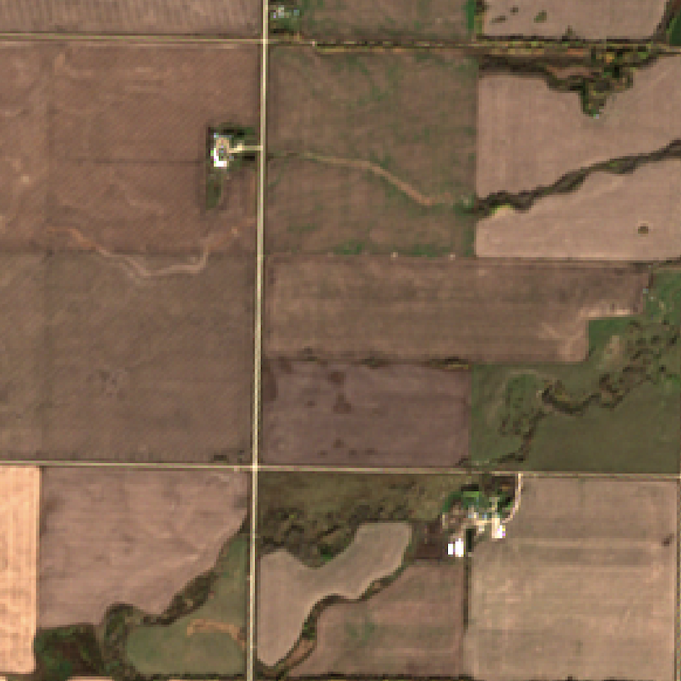
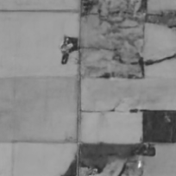
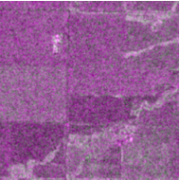
Modalities
Modality-wise Tokenization
Correlation Learning
Downstream Applications
Sentinel-2 L2A
Sentinel-2 L1C
Sentinel-2 RGB
Pixel-level input
Multimodal Generation
Sampled target tokens
…
S-2 L2A
…
S-2 L1C
Patch Embed.
Sentinel-1 GRD
Sentinel-1 RTC
…
S-2 RGB
Cross Entropy Loss
…
S-1 GRD
…
S-1 RTC
Generate data based on learned correlations
Digital Elevation Model (DEM)
…
DEM
TerraMind Decoder
Fine-tuning
Token-level input
Vegetation index (NDVI)
…
S-2 L2A
Encoder
Task decoder
Image Token-ization
…
S-1 GRD
…
S-1 RTC
Mask tokens
Land-use/ land-cover maps (LULC)
…
DEM
Native support for multi-modal inputs
…
NDVI
…
LULC
TerraMind Encoder
Thinking in Modalitites (TiM)
Image caption
A satellite image of a coastline with …
Text Token-ization
Sequence input
Model
…
Caption
Coordinates at 0.25 x 0.25 deg
0°50′N 122°75′E
Coords
Sampled input tokens
TiM tuning with generated modalities
Jakubik, J., Yang, F., Blumenstiel, B., Scheurer, E., Sedona, R., Maurogiovanni, S., ... & Longépé, N. (2025). TerraMind: Large-Scale Generative Multimodality for Earth Observation. arXiv preprint arXiv:2504.11171.

Slide 9
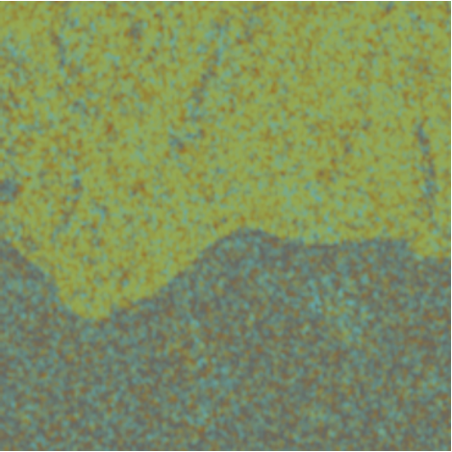
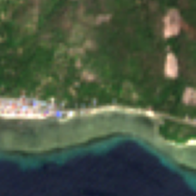
Any-to-any generation
Predicted tokens
Input
…
…
Generation
TerraMind Encoder
TerraMind Decoder
Diffusion
Decoder
…
…
Input patches
Mask tokens of target modality

Slide 10
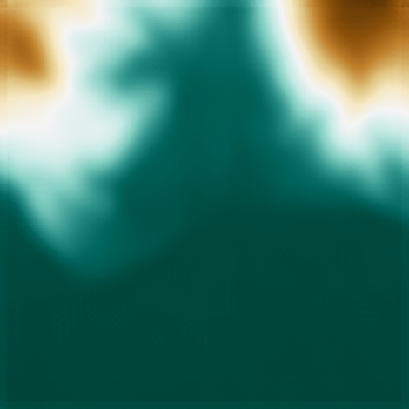
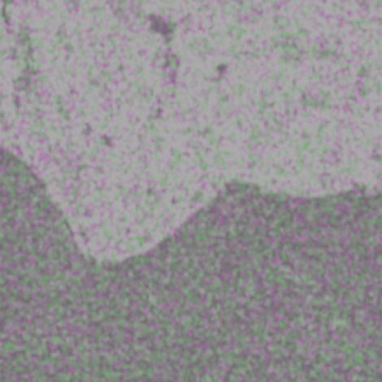
Chained generation for consistent generations
Predicted tokens
Input
…
Generation
TerraMind Encoder
TerraMind Decoder
Diffusion
Decoder
…
…
…
…
Generated tokens
Input tokens
Mask tokens of next target modality

Slide 11
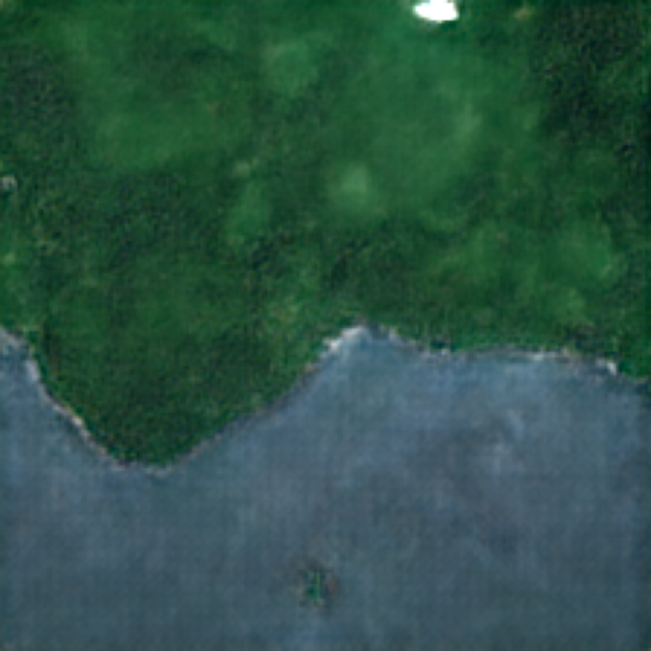
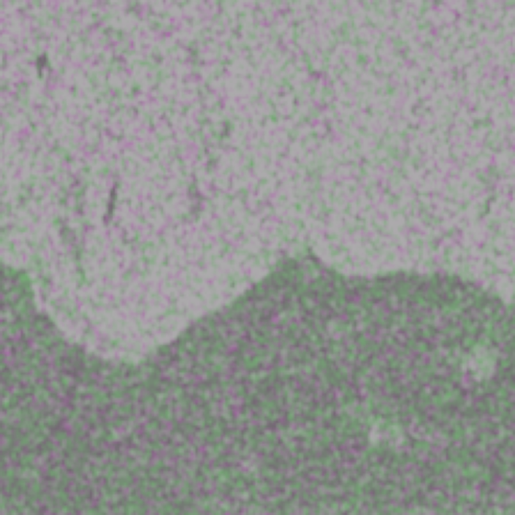
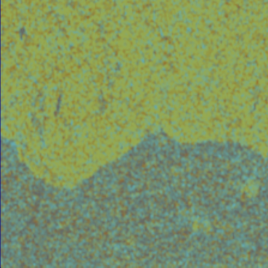


Chained generation for consistent generations
Raw Input
Sentinel-2 L2A
Sentinel-1 RTC
DEM
LULC
NDVI
Generation
Consistency between generated modalities
Generation
Generation

Slide 12
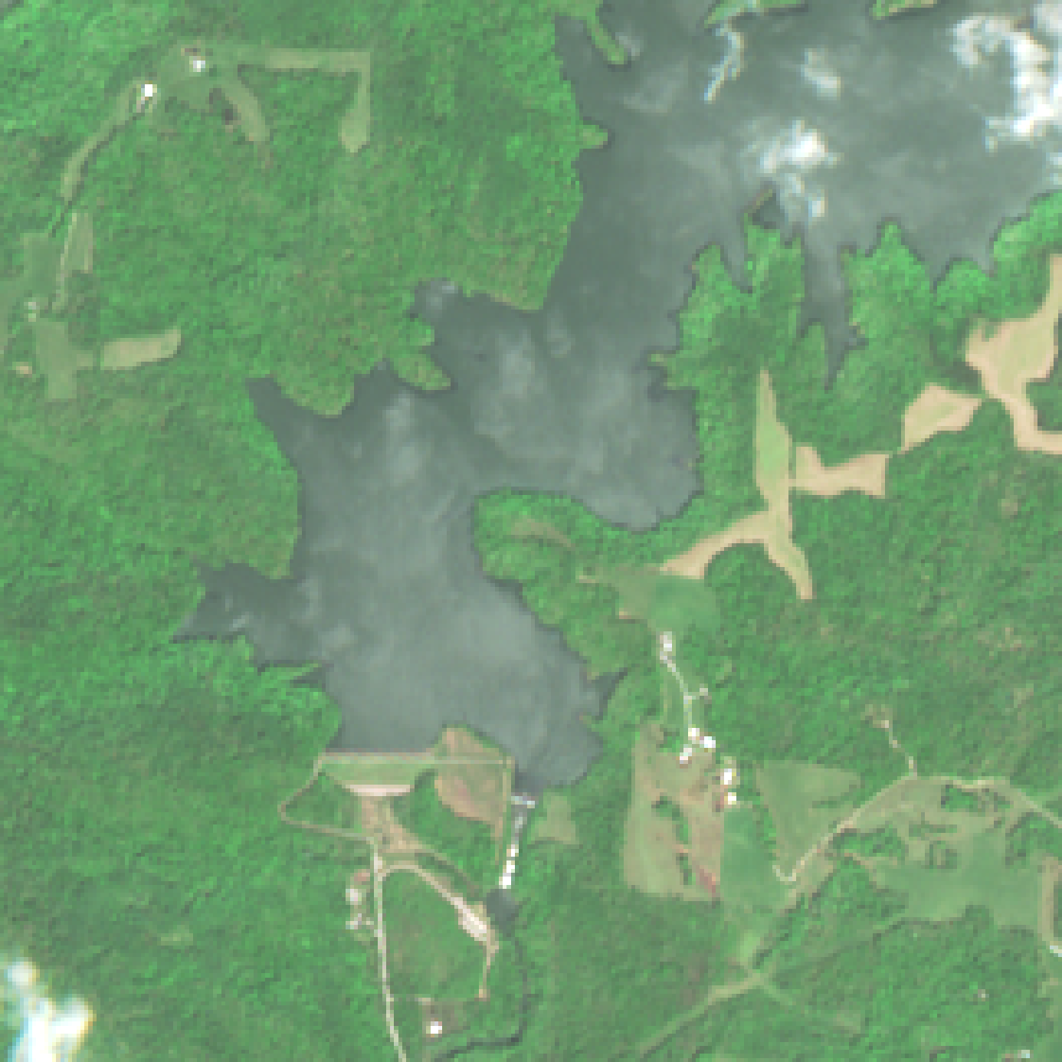
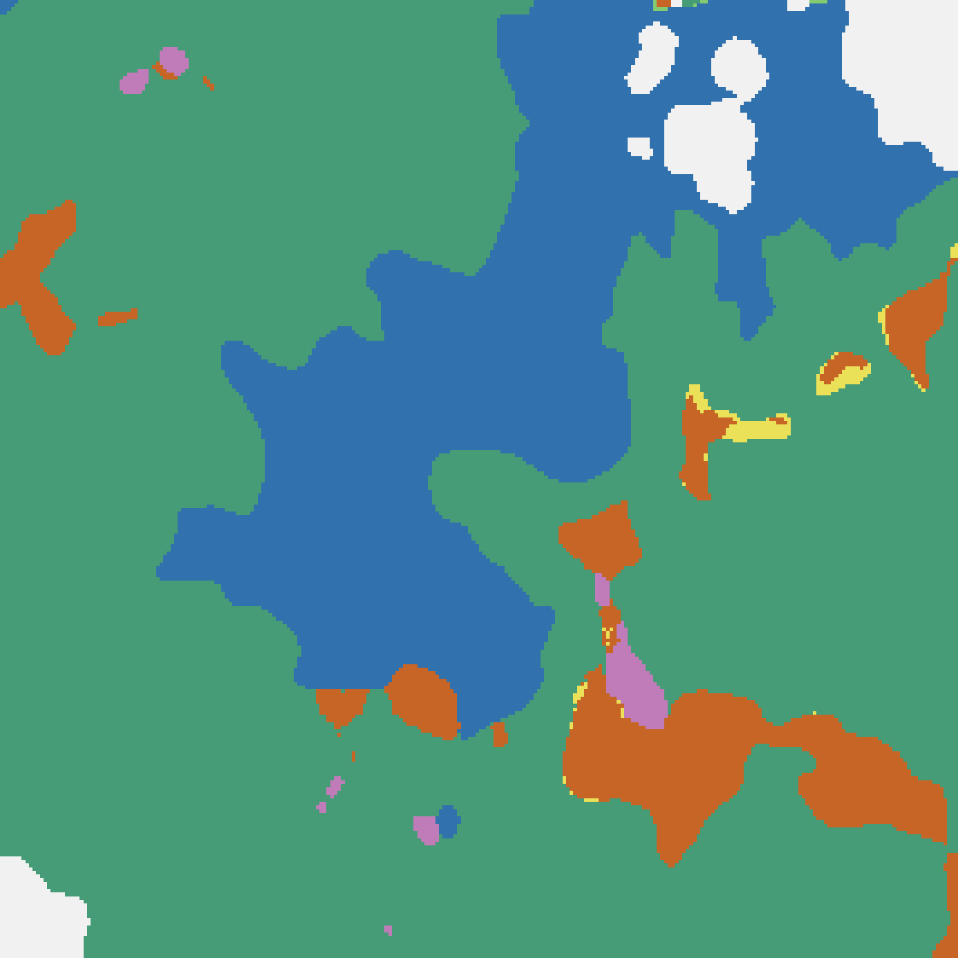
Thinking in Modalities
Standard fine-tuning
TerraMind enables to enhance fine-tuning by
Thinking-in-Modalities (TiM) – generating intermediate artificial data of other modalities.
The raw image and the generated tokens are used as input by the fine-tuned model.
TerraMind Encoder
Task decoder
TiM fine-tuning with intermediate modalities
Model
…
TerraMind

Slide 13
How does TerraMind perform?

Slide 14
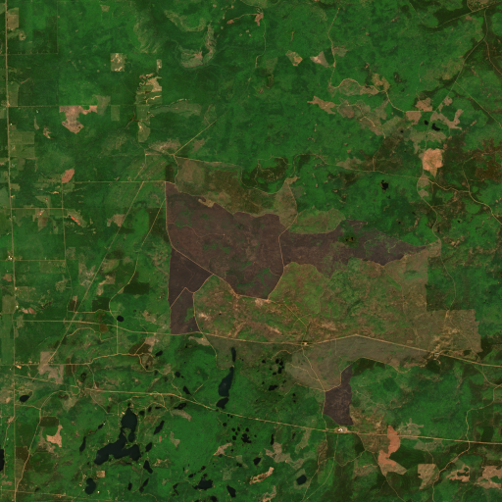
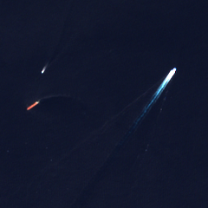
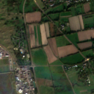
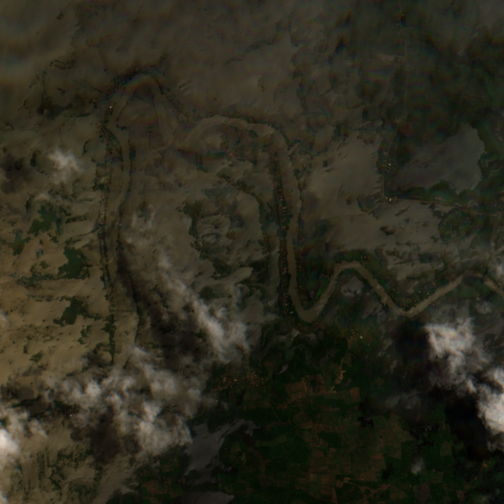
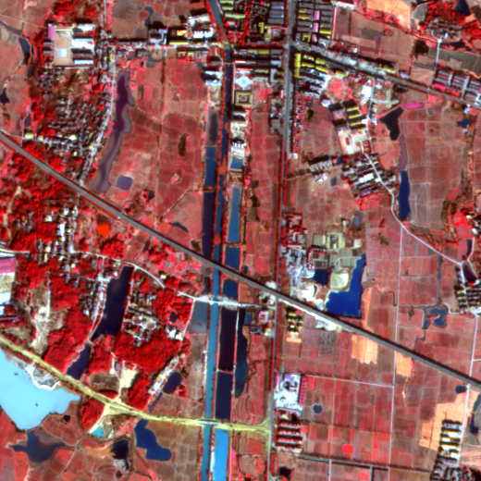
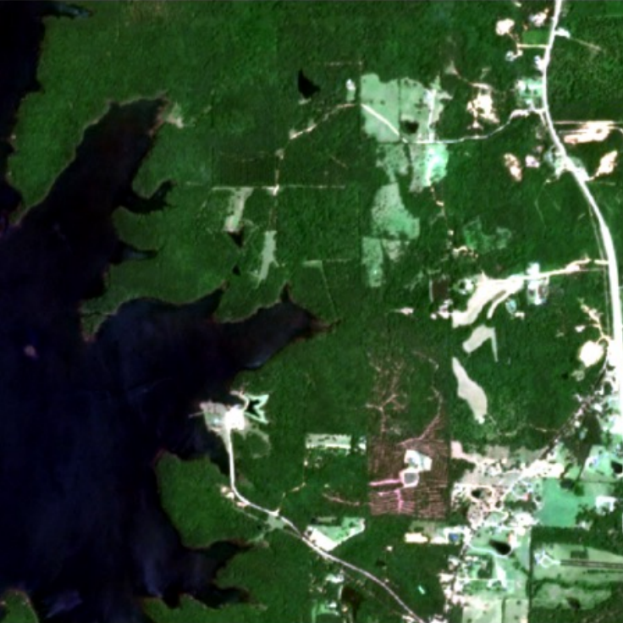
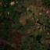
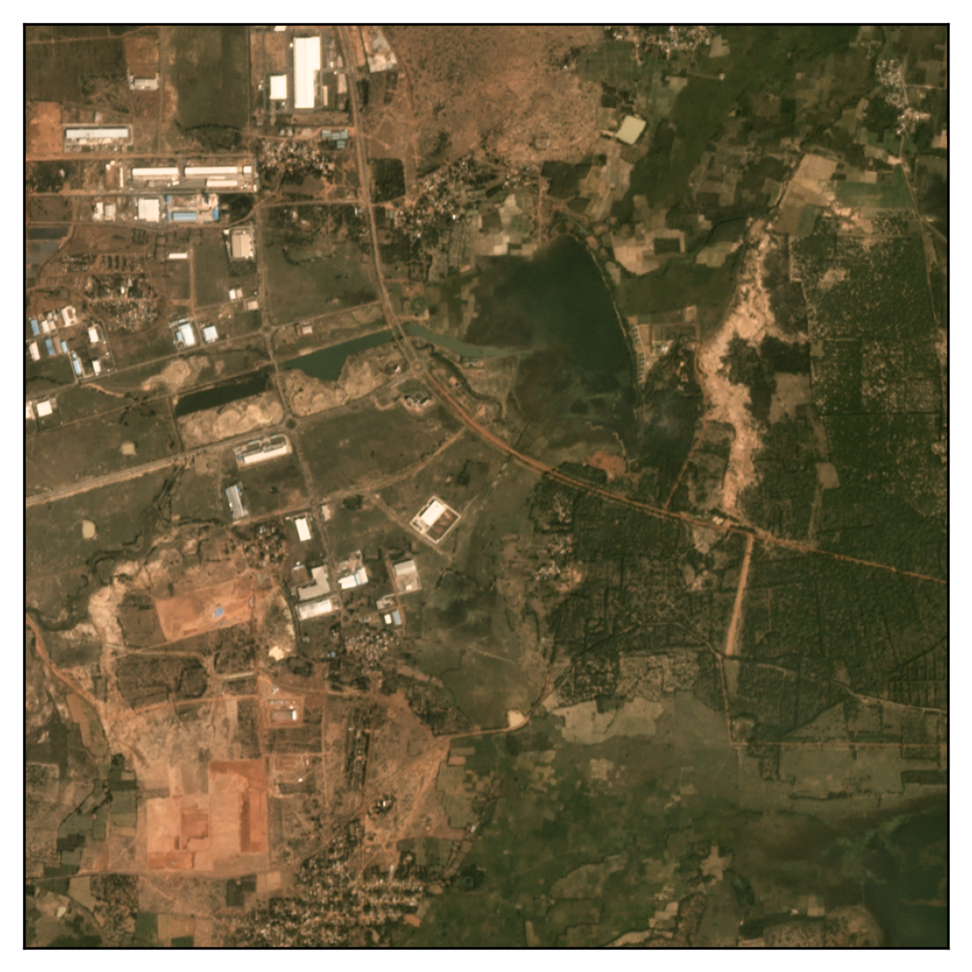























PANGAEA bench – nine diverse downstream tasks
BurnScars
MADOS
PASTIS
Sen1Fl11
FBP
DynamicEN
CTM-SS
SpaceNet7
AI4Farms
BioMasters
xView
HLS
S-2 L2R
S-2 L2A
S-2 L1C
Gaofen-2
Planet
S-2 L2A
Planet
S-2 L2A
S-1 GRD
S-1 GRD
S-1 SLC
Wildfire
Marine
Agriculture
Flood
Land cover
Land cover
Agriculture
Change det.
Agriculture
Marsocci, V., Jia, Y., Bellier, G. L., Kerekes, D., Zeng, L., Hafner, S., ... & Nascetti, A. (2024). PANGAEA: A global and inclusive benchmark for geospatial foundation models. arXiv preprint arXiv:2412.04204.
Notes:
TODO: Check PASTIS levels!

Slide 15
PANGAEA bench results
PANGAEA bench results for TerraMind and the top 5 EO FMs based on average rank. The mIoU is visualized on a normalized scale.
Notes:
- Improve over other GeoFMs by at least 8% on average, best model available

Slide 16
PANGAEA bench
Performance evaluation of TerraMind across nine benchmark datasets using the PANGAEA evaluation protocol. Higher mIoU (↑) and lower rank values (↓) are reported. The best model is highlighted and the second best is underscored.
Model | BurnSr | MADOS | PASTIS | Sen1Fl11 | FBP | DEN | CTM-SS | SN7 | AI4Farms | Avg. mIoU | Avg. Rank
CROMA | 82.42 | 67.55 | 32.32 | 90.89 | 51.83 | 38.29 | 49.38 | 59.28 | 25.65 | 55.29 | 6.61
DOFA | 80.63 | 59.58 | 30.02 | 89.37 | 43.18 | 39.29 | 51.33 | 61.84 | 27.07 | 53.59 | 8.22
GFM-Swin | 76.90 | 64.71 | 21.24 | 72.60 | 67.18 | 34.09 | 46.98 | 60.89 | 27.19 | 52.42 | 10.00
Prithvi 1.0 100M | 83.62 | 49.98 | 33.93 | 90.37 | 46.81 | 27.86 | 43.07 | 56.54 | 26.86 | 51.00 | 11.00
RemoteCLIP | 76.59 | 60.00 | 18.23 | 74.26 | 69.19 | 31.78 | 52.05 | 57.76 | 25.12 | 51.66 | 11.22
SatlasNet | 79.96 | 55.86 | 17.51 | 90.30 | 50.97 | 36.31 | 46.97 | 61.88 | 25.13 | 51.65 | 10.67
Scale-MAE | 76.68 | 57.32 | 24.55 | 74.13 | 67.19 | 35.11 | 25.42 | 62.96 | 21.47 | 49.43 | 11.44
SpectralGPT | 80.47 | 57.99 | 35.44 | 89.07 | 33.42 | 37.85 | 46.95 | 58.86 | 26.75 | 51.87 | 10.11
S.-S12-MoCo | 81.58 | 51.76 | 34.49 | 89.26 | 53.02 | 35.44 | 48.58 | 57.64 | 25.38 | 53.02 | 10.06
S.-S12-DINO | 81.72 | 49.37 | 36.18 | 88.61 | 51.15 | 34.81 | 48.66 | 56.47 | 25.62 | 52.51 | 10.89
S.-S12-MAE | 81.91 | 49.90 | 32.03 | 87.79 | 51.92 | 34.08 | 45.80 | 57.13 | 24.69 | 51.69 | 12.39
S.-S12-Data2Vec | 81.91 | 44.36 | 34.32 | 88.15 | 48.82 | 35.90 | 54.03 | 58.23 | 24.23 | 52.22 | 10.72
UNet Baseline | 84.51 | 54.79 | 31.60 | 91.42 | 60.47 | 39.46 | 47.57 | 62.09 | 46.34 | 57.58 | 4.89
ViT Baseline | 81.58 | 48.19 | 38.53 | 87.66 | 59.32 | 36.83 | 44.08 | 52.57 | 38.37 | 54.13 | 10.28
TerraMindv1-B | 82.42 | 69.52 | 40.51 | 90.62 | 59.72 | 37.87 | 55.80 | 60.61 | 28.12 | 58.35 | 3.94
TerraMindv1-L | 82.93 | 75.57 | 43.13 | 90.78 | 63.38 | 37.89 | 55.04 | 59.98 | 27.47 | 59.57 | 3.44
Jakubik, J., Yang, F., Blumenstiel, B., Scheurer, E., Sedona, R., Maurogiovanni, S., ... & Longépé, N. (2025). TerraMind: Large-Scale Generative Multimodality for Earth Observation. arXiv preprint arXiv:2504.11171.

Slide 17
Average mIoU
MADOS
Burn Scars
FiveBillionPixels
S-2 L2R
HLS
Gaofen-2
TerraMind is the first EO FM to outperform a fully fine-tuned UNet.
Very good performance on pre-training input modalities like S-2.
Competitive results on domain shifts like different inputs (HLS).
High resolution inputs are challenging for most geospatial FMs.

Slide 18

Improvements with multi-modality
Multimodal inputs consitently improve the TerraMind performance on PANGAEA benchmark datasets.
Input | PASTIS | Sen1Fl11 | CTM-SS
Sentinel-1 | 20.04 | 80.39 | 24.45
Sentinel-2 | 40.20 | 89.57 | 50.90
Multimodal | 40.51 | 90.62 | 55.80

Slide 19



Thinking in Modalities
Comparision between the standard approach with full fine-tuning and
Thinking-in-Modalities (TiM) tuning using generated LULC tokens as additional inputs.
Potential TiM modalities for TerraMind include S-2, S-1, LULC, DEM, NDVI, and coordinates.
Dataset | Model | Input | IoU_{Water} | mIoU
Sen1Floods11 | TerraMind-B TerraMind-B TiM | Sentinel-1 S-1 + gen. LULC | 68.00 72.25 | 81.06 83.65
 | TerraMind-B TerraMind-B TiM | Sentinel-2 S-2 + gen. LULC | 82.26 84.75 | 89.70 91.14
SA Crop Type | TerraMind-B TerraMind-B TiM | Sentinel-2 S-2 + gen. LULC | – | 41.87 42.74

Slide 20








Few-shot experiments
How one-shot classification works:
1-shot 5-way classification results using nearest neighbors, measured in accuracy and averaged over 200 runs. TerraMind outperforms benchmarks from CV and EO, suggesting a well-structured latent space.
Labeled data (support set)
Unlabeld data (query set)
Model | Input | EuroSAT | METER-ML
CLIP-ViT-B/16 | S-2RGB | 52.39 | 28.13
 | NAIP | – | 31.73
DeCUR | S-2 L1C | 50.54 | 27.87
Prithvi EO 1.0 | S-2 L1C | 60.11 | 26.08
Prithvi EO 2.0 | S-2 L1C | 61.06 | 28.26
TerraMind-B | S-2 L1C | 70.83 | 33.90
 | NAIP | – | 32.23
Crop
Highway
River
Classification based on shortest distance in the embedding space
1-shot 5-way defines a setting with five randomly sampled classes with one labeled example each.

Slide 21
Neural compression benchmark
R² results of TerraMind, other FMs and baselines on image compression tasks from a CVPR EarthVision challenge.
The well structured embedding space of TerraMind outperforms all other tested models.

Slide 22
Insights
SOTA Performance
TerraMind reaches state-of-the-art performance on PANGAEA bench.
Multi-modal inputs
TerraMind is trained with various modalties, natively supporting multi-modal fine-tuning.
Thinking-in-Modalites
TerraMind introduces a new intermediate step and imagines how other modalities look like.
Embedding space
TerraMind embeddings are well suited for few-shot classification or image retrieval tasks.

Slide 23


Try it for yourself!
Open-source!
We ♥︎ Open source!
All models are released on Hugging Face under the Apache 2.0 license.
https://huggingface.co/ibm-esa-geospatial

Slide 24


TerraMind webpage is now online https://ibm.github.io/terramind/

Slide 25

We want to see what you can build with TerraMind!
TerraMind Blue-Sky Challenge
Get inspired and submit your idea with TerraMind at:
https://huggingface.co/spaces/ibm-esa-geospatial/challenge
A bi-monthly award spotlighting the boldest, most imaginative ways to push TerraMind beyond “just another fine-tune”. You can win 4 x €1 000 prize money.
See Terms & Conditions at https://huggingface.co/spaces/bm-esa-geospatial/challenge.

Slide 26


Thank you!
Find more information about TerraMind at
https://huggingface.co/ibm-esa-geospatial

